Slide 1
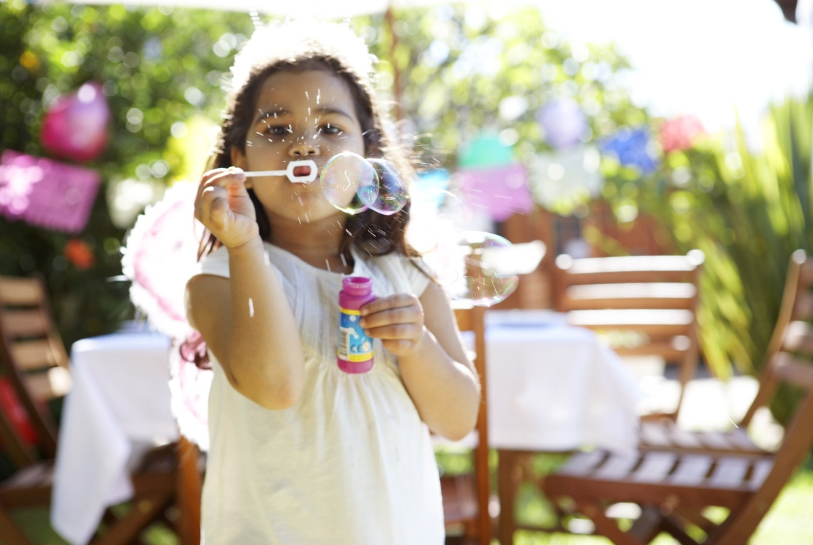
“Summer of Kindness”
Kendralyn Burr
Notes:
NOTE: To change images on this slide, select a picture and delete it. Then click the Insert Picture icon
in the placeholder to insert your own image.

Slide 2
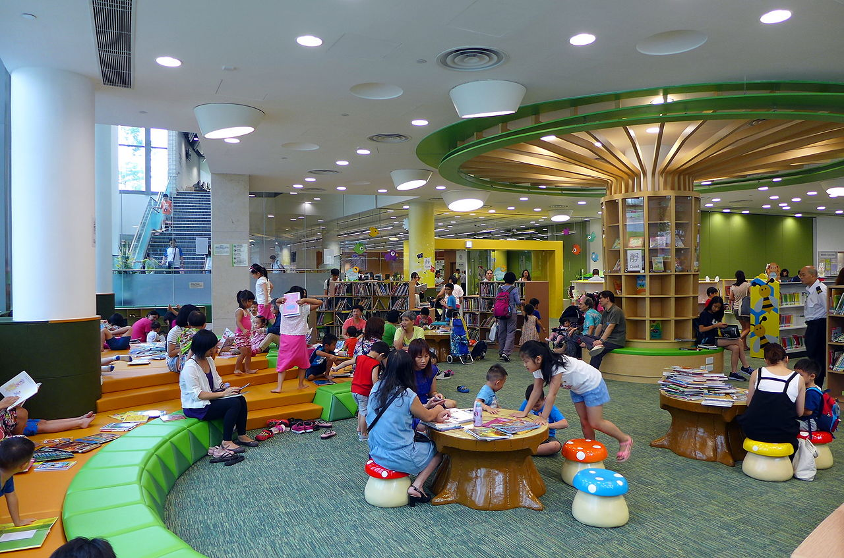
Program Background
Golden Public Library
524 Golden St., Colorado Springs, CO
Youth Services Librarian: Kendralyn Burr
Time Period: June, July, & August
Theme: Summer of Kindness
Website: www.goldenpl.com
This Photo by Unknown Author is licensed under CC BY-SA

Slide 3

Summer Storytime Sessions
Date: Mondays between 06/03/19 – 08/26/19
Time: 10:00 AM
Maximum Number of Participants: 30
Age of Participants: 0 - 6
Number of staff needed to assist with program: 1
Supplies: Library books, craft supplies, light snacks
Cost of Program: $240.00 ($20 per week)
Program Breakdown: Children and parents can attend a weekly Storytime session. Each session contains songs, books, and crafts related to the “Summer of Kindness” theme.

Slide 4

Summer Book Club
Date: Every other Tuesday between 06/04/19 – 08/27/19
Time: 3:00 PM
Maximum Number of Participants: 30
Age of Participants: 13 - 18
Number of staff needed to assist with program: 1
Supplies: Snacks & Drinks
Cost of Program: $150 ($25 per week)
Program Breakdown: Club will meet bi-weekly to discuss books from the “Summer of Kindness” reading list.

Slide 5

Movie Day in our PJ’s
Date: Saturday, July 13, 2019
Time: 1:00 PM
Maximum Number of Participants: 30
Age of Participants: 3 - 12
Number of staff needed to assist with program: 1
Supplies: Movies (Up & Wonder), Popcorn, Drinks & Pizza
Cost of Program: $250
Program Breakdown: Participants will come to the library in their pajamas for a night of movies and snacks. We will watch the movies Up and Wonder. Snacks provided will be pizza, popcorn, drinks, and cookies. Movies provide examples of kindness and teaches children ways to be kind to others.

Slide 6

Make Someone’s Day
Date: Wednesday, June 8, 2019
Time: 1:00 – 3:00 PM
Maximum Number of Participants: 30
Age of Participants: 0-18
Number of staff needed to assist with program: 1
Supplies: Craft Supplies, Snacks
Cost of Program: $75 (snacks and supplies)
Program Breakdown: Participants will learn to show kindness by writing letters and making cards to give to others. Some letters/cards will be given to friends, family, and children at a local children’s hospital. Others will even be left in library books to put a smile on readers faces. Snacks provided will include cookies, chips, & drinks.

Slide 7

Red White & Blue Day
Date: Wednesday, July 3, 2019
Time: 11:00 AM
Maximum Number of Participants: 30
Age of Participants: 5 - 12
Number of staff needed to assist with program: 2
Supplies: Craft Supplies, Food, Snow Cone Machine (provided by librarian), ice, cups, plates, spoons, napkins. and syrup.
Cost of Program: $250
Program Breakdown: Activities include writing kind letters/cards to deployed and local military members. A picnic outside the library will follow the craft. Picnic will include sandwiches, chips, and red, white, and blue snow cones.

Slide 8

All About Dad
Date: Saturday, June 15, 2019
Time: 12:00 – 2:00 PM
Maximum Number of Participants: 30
Age of Participants: 0 – 12
Number of staff needed to assist with program: 2
Supplies: Posters, Craft supplies & Snacks
Cost of Program: $250
Program Breakdown: Activities include stories told by different fathers and a craft. The craft consists of a poster to celebrate each child’s father or father figure using photos, old magazines and drawings. Children can give the poster as a gift on Father’s Day. Snacks will be provided such as cheese, crackers, and grapes.

Slide 9
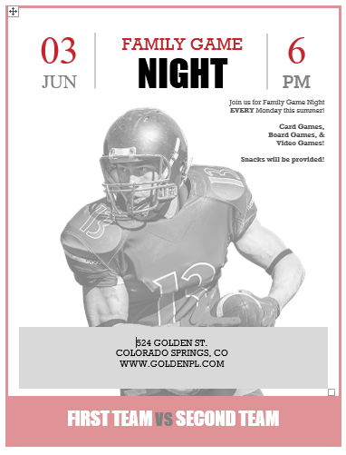
Family Game Night
Date: Mondays between 06/03/19 – 08/26/19
Time: 6:00 PM
Maximum Number of Participants: 30
Age of Participants: All Ages
Number of staff needed to assist with program: 1
Supplies: Cards, Board Games, Video Games, Snacks & Drinks
Cost of Program: $240.00 ($20 per week for snacks)
Program Breakdown: We will show kindness to our families by providing an opportunity to spend time together. Families can come in and start games with their own families or battle other families in games such as Family Feud, Trivia, and Bingo. Snacks will be provided such as cookies, chips, popcorn and drinks.

Slide 10

Teen Game Night
Date: Fridays between 06/07/19 – 08/30/19
Time: 6:00 PM
Maximum Number of Participants: 30
Age of Participants: 13 - 18
Number of staff needed to assist with program: 1
Supplies: Cards, Board Games, Video Games, Snacks & Drinks
Cost of Program: $240.00 ($20 per week for snacks)
Program Breakdown: Teens may struggle to get along with classmates. This program will provide an opportunity to show kindness to our peers and have fun together by playing games such as board, card, and video games. Snacks will be provided such as popcorn, chips, cookies, and drinks.

Slide 11

Teen Paint Night
Date: Saturday, June 29, 2019 Time: 6:00 – 8:00 PM
Maximum Number of Participants: 15
Age of Participants: 13 - 18
Number of staff needed to assist with program: 1
Supplies: Paint supplies provided by artist, sparkling non-alcoholic drinks
Cost of Program: $250 ($25 per person/supplies + $200 local artist fee + $25 drinks/plastic glasses)
Outside Entertainment: Holly B., 1045 Garden Rd. Colorado Springs, CO.
Program Breakdown: Teens will have a fun night together to paint a picture to give as a gift to family or friends. Sparkling non-alcoholic drinks and water will be provided in plastic glasses.

Slide 12

Be Kind to Yourself
Date: Saturday, August 31, 2019
Time: 2:00 – 4:00 PM
Maximum Number of Participants: 15
Age of Participants: 13 - 18
Number of staff needed to assist with program: 1
Supplies: DIY supplies/containers, Yoga video, Yoga mats, Paper, Pen, Pencils.
Cost of Program: $250
Program Breakdown: Our final program encourages the act of being kind to ourselves and self love. Activities included yoga exercises, writing appreciation letters to ourselves, and take home DIY projects (soap, body scrub, & bath bombs).

Slide 13
Promotions for All Programs
Social media announcements
In-house flyers
Articles placed in local newspaper
Librarian will visit local schools with flyers before the end of the semester

Slide 14
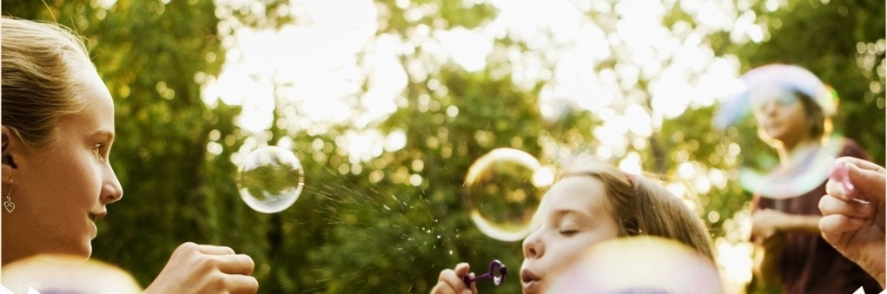
Thank you!
See you soon at our programs!
Notes:
NOTE: To change images on this slide, select a picture and delete it. Then click the Insert Picture icon
in the placeholder to insert your own image.

